Slide 1
Strategic Planning, Major Initiatives Division of Collections & Digital Services 2020-2023
Ray Uzwyshyn, Director Collections and Digital Services
Misty Hopper, Head of Cataloging & Metadata Services
Todd Peters, Head of Digital & Web Services
Ginger Williams, Head of Acquisitions
2020-2023
Collections & Digital Content

Slide 2
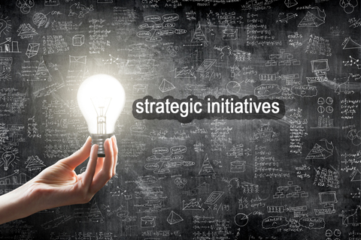
CDS Planning Process Strategic Initiatives 2020-2023
October 20, Joan asks Directors to begin thinking about Strategic Planning
October 25, First CDS Strategic Planning Meeting, 5-7 major strategic Initiatives/dept. for the next 2-3 years using previous strategic plan categories as rubric.
October 25-November 6, Department heads meet with staff to develop initiatives, meet with Ray
November 6 Strategic Planning First Drafts Meeting, Dept Heads present first drafts, Discussion for comments/changes
November 18, Ray presents draft Initiatives to AVP & UL Joan Heath for review edits/comments
November 19-December 1st, Final Edits Changes and Presentation Prep

Slide 3
Major Strategic Initiatives (2020-2023) Division of Collections and Digital Services
16 Major Initiatives
Total CDS Strategic Initiatives
Project Durations
2020-2023
Vary from 1-5 years, Most Projects 2 year timeline
Strategic Themes Represented (Plan) Collections and Digital Content (9) Scholarship & Research (3) Library Spaces (2) Partnerships, Outreach and Engagement (1) Library Experience (1)
Strategic Initiatives by Department Acquisitions (6 Initiatives) Digital and Web Services (4 Initiatives) Cataloging and Metadata Services (6 Initiatives) Range of Small, Medium, Large and X-Large Initiatives
Collections & Digital Content

Slide 4
Acquisitions Strategic Initiatives (6)
Assessment of Inclusion and Diversity in Collections 20/23 Assessment of Subscription Packages 21/23 Collections Transfer to Round Rock Campus (RRC) 21
Collections Transfer to the Archival Research Center 21/22 Project for Texas Library Coalition United for Action 20/23, Implementation of Alternative Access Journal Content Infrastructure 20/21 Themes Collections and Digital Content (3) Library Spaces (1) Partnerships, Outreach and Engagement (1) Scholarship & Research (1)

Slide 5
Digital and Web Services Strategic Initiatives (4)
Implementation of new digital repository infrastructure 20/21 Larger Data Storage Project 20/22, Marketing Infrastructure for the Digital Collections Repository and Data Repository 20/23 Increased Levels of Digitization for our Important Local Collections 20/23 Themes Collections and Digital Content (2) Scholarship and Research (2)

Slide 6
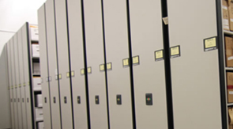
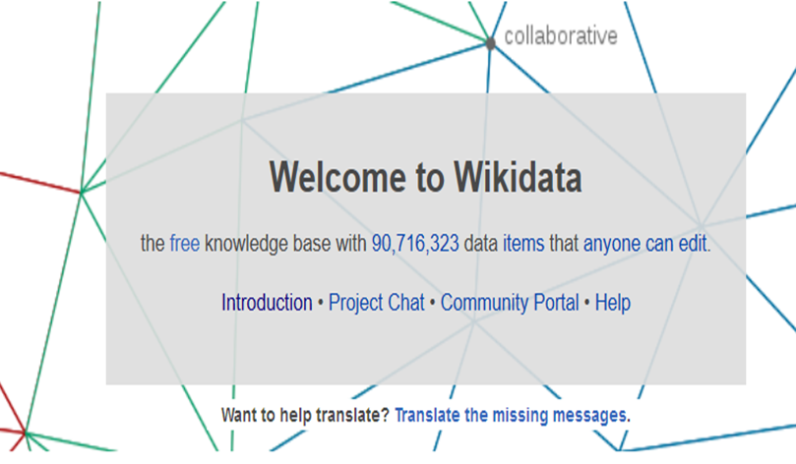
Cataloging and Metadata Services Strategic Initiatives (6)
(Two Part) RFID Preparation/Implementation Project 20/22 Large Compact Shelving Clearance Project 20/25 Processing Schneider Music Library LP Collections 20/21 Large Merging E-Resources/Catalog Project 20/22, Innovative Linked Data/Wikidata Project 20/22 Themes Collections & Digital Content (4) Library Spaces (1) Library Experience (1)

Slide 7
Strategic Initiative: Assess subscription packages
For budget sustainability and support for transforming scholarly publishing system.
Use Unsub to model impact of unbundling
Work with consortia to secure more favorable terms for university-affiliated authors, such as APC discounts and copyright retention
Focus on 1-3 packages annually as multi-year contracts expire
Collections & Digital Content
Acquisitions
2020-2023

Slide 8
Strategic Initiative: Assess Inclusion and Diversity in Collections
Research how other libraries have assessed collection support for diversity and inclusiveness.
Develop assessment plan.
Implement plan for assessing collection.
Develop plan to address any needed improvements, with budget implications.
Begin implementation, with periodic re-assessment.
Collections & Digital Content
Acquisitions
2021-2023

Slide 9
Strategic Initiative: Assess & Transfer Collections to RRC
Identify and assess use of collection materials acquired for HIM and Radiation Therapy.
Work with faculty to prioritize items to move.
Identify any materials that support programs remaining in San Marcos and acquire duplicates if needed.
Transfer items prior to the departments relocating for Fall 2021.
Collections & Digital Content
Acquisitions, Cataloging, and RRC
FY2021

Slide 10
Strategic Initiative: Review general collection for weeding/transfer to ARC
Revise weeding process for general collection
Update to a weed/transfer process
Goal is to review portions of the collection annually and designate items for weeding or transfer to ARC to maintain attractive spaces
Draft procedures and implement on small scale in FY21, revise as needed, implement as routine activity in FY22.
Library Spaces
Acquisitions
FY2021-22

Slide 11
Strategic Initiative: Work with Texas Library Coalition United for Action (TLCUA)
Negotiate for improved access to scholarship, greater control over faculty content, and sustainable pricing models.
FY2021: Focus on Elsevier Science Direct negotiation.
Future years depend on Steering Committee priorities.
Partnerships, Outreach & Engagement
Acquisitions
2020-23

Slide 12
Strategic Initiative: Recommend alternative access to journal content
Recommend alternative access methods to implement in the event subscription access is lost.
Outline ways to assess user needs and effectiveness of strategies to ensure appropriate mix of methods going forward
Create webpage for university community outlining alternative access methods to content lost
Develop guidelines for any recommended new services/subscriptions
Scholarship & Research
Ginger Williams, Paivi Rentz, Taskforce
2020-21

Slide 13
Strategic Initiative: Fedora-Based Repository
Implement a new repository using Islandora/Fedora or Samvera/Fedora for non-scholarship items currently located in the Dspace-based Digital Collections Repository.
Collections & Digital Content
Digital & Web Services
2020-21

Slide 14
Strategic Initiative: Fedora-Based Repository
Current Environment
Digital Collections Repository – 2 types of material
Scholarship – Journal Articles, Electronic Thesis & Dissertations
Archival Materials – University Archives, Wittliff Collections
Powered by Dspace software
Developed for scholarship, mainly PDF
Limited ability to display exhibits with modern technologies
Mixed content types create branding difficulties for scholarship repository
Would like to change name to something like Scholarship Repository
Collections & Digital Content
Digital & Web Services
2020-21

Slide 15
Strategic Initiative: Fedora-Based Repository
Fedora-Based Repository
Provide a platform that allows the creation of modern, responsive, mobile friendly, ADA compliant exhibits.
Based on open-source software.
Fedora – repository backend
Islandora, Spotlight, Blacklight, Samvera front ends
Islandora is built on Drupal Content Management Server
Collections & Digital Content
Digital & Web Services
2020-21

Slide 16
Strategic Initiative: Digitization of Important Local Collections
Significantly increase University Archives and Wittliff Collections objects in Digital Collections.
Wittliff Collections: Continue with projects as identified by Digital Projects Oversight Group .
University Archives: continue digitizing unlabeled negatives, thesis, San Marcos Daily Record negatives.
Digitize and add 30,000 objects to the Digital Collections Repositories.
Collections & Digital Content
Digital & Web Services
2020-23

Slide 17
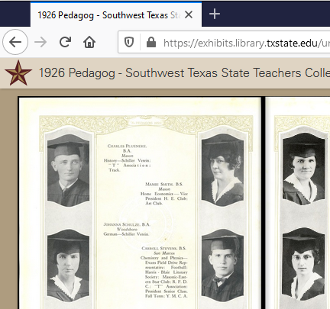
Example Completed Projects
Pedagog
Collections & Digital Content
Digital & Web Services
2020-23

Slide 18
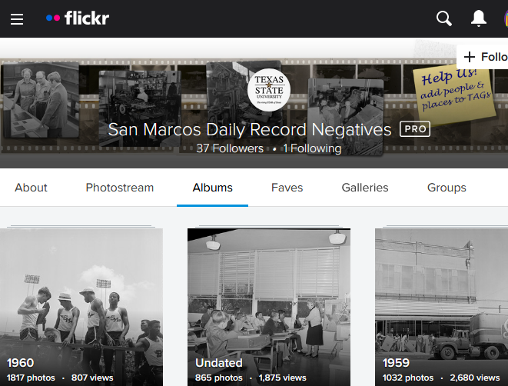
Example Completed Projects
12,552 photos on Flickr from Univ Archives and San Marcos Daily Record
Collections & Digital Content
Digital & Web Services
2020-23

Slide 19
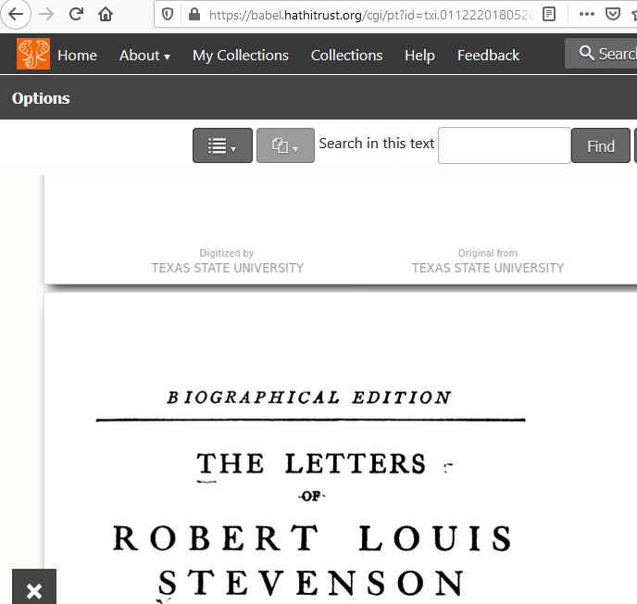
Example Completed Projects
Contributed 22 volumes to HathiTrust Digital Library
Collections & Digital Content
Digital & Web Services
2020-23

Slide 20
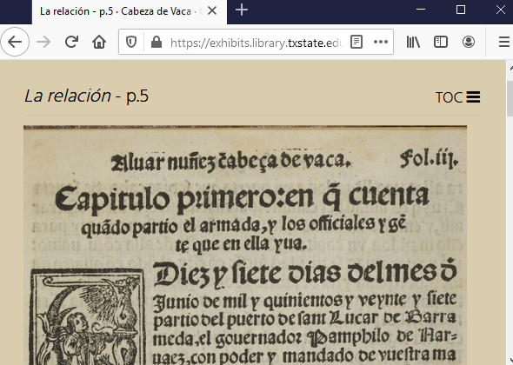
Example Completed Projects
Cabeza de Vaca
Collections & Digital Content
Digital & Web Services
2020-23

Slide 21
Strategic Initiative: TDL Larger Attached Storage Project
Work with Technology Resources and the Texas Digital Library to implement S3 compatible storage at Texas State University and integrate with the Texas Data Repository (TDR) for storage of data objects greater than 10GB in size.
Scholarship & Research
Digital & Web Services
2020-22

Slide 22
Strategic Initiative: TDL Larger Attached Storage Project
TDR is a Texas Digital Library initiative
Shared repository
Uses Dataverse software
Limit of 10GB per dataset, Faculty need more
Pilot project
Allow data files to be uploaded to local University storage using Amazon’s S3 file storage protocol
TXSTATE IT will need to install S3 compatible storage
Scholarship & Research
Digital & Web Services
2020-22

Slide 23
Strategic Initiative: Promote the Digital Collections Repository and Texas Data Repository
Assist faculty, staff, and students with deposits; and offer presentations and consultations in collaboration with the Scholarly Communication Team, RIO, and University Libraries Marketing including at least one presentation at the TXST Round Rock Campus per year.
Scholarship & Research
Digital & Web Services
2020-23

Slide 24
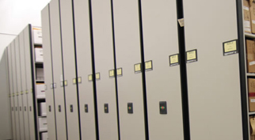
Strategic Initiative:
Clear 4th Floor Compact Shelving
Clear all materials shelved in the compact shelving to make room for future library renovations.
Retro-catalog all uncataloged materials
Relocate items to the ARC or Alkek stacks
Weed items no longer needed for the collection
A special thank you to all staff who have continually helped with this project since it began in FY2020.
Library Spaces
Cataloging & Metadata Services & RLS
2020-2025

Slide 25
Strategic Initiative:
RFID Alkek Library Collections
What is RFID?
RFID tags will program an item’s barcode and other information to each tagged library item.
This programming will:
Enhance and improve security
Improve check-out/check-in services
Implement a stacks inventory system
RFID 2 Year Conversion Project:
Small Projects: Alkek 1 equipment, 2nd floor items, 3rd floor collections
Large Projects: 6th floor will be completed first. Then the 5th floor.
CDS and RLS staff will manage and staff projects.
Library Experience
Project Managers:
Misty Hopper
Paivi Rentz
2020-2022

Slide 26
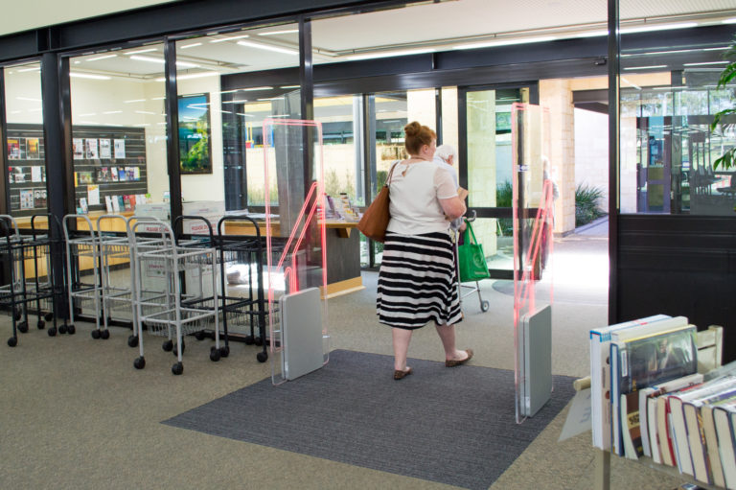
Strategic Initiative:
RFID Alkek Library Collections
Security Gates
What happens when an item which is not checked out goes through gate?
Alert: we can program audible and/or visual warning
Report: Gates will detect, identify, and report any item which is taken through the gate without being checked out.
Library Experience
Project Managers:
Misty Hopper
Paivi Rentz
2020-2022

Slide 27
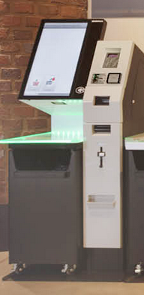
Strategic Initiative:
RFID Alkek Library Collections
Circulation Services
Stacks of items can be read at once when placed on RFID read pads, enabling improved patron services and self-checkout.
Upon check-out/in, RFID label security signal is automatically turned off or on. (No more de-tuner labels)
Self-checkout stations will be installed on multiple floors in Alkek.
Due to the length of time it will take to convert the entire Alkek collections. There will be two phases for self-checkout scanning:
Phase 1: Barcode scans
Patrons must scan individual barcodes
Phase 2: RFID scans
Library Experience
Project Managers:
Misty Hopper
Paivi Rentz
2020-2022

Slide 28
Strategic Initiative:
RFID Alkek Library Collections
Stacks Inventory
Sierra shelf-lists are uploaded to the inventory wand
When scanning the shelves, wand reports information such as:
Out of call number order
Missing items
Non-available status items (such as claimed returned)
Identify other problems (wrong collection, etc.)
Library Experience
Project Managers:
Misty Hopper
Paivi Rentz
2020-2022

Slide 29
Strategic Initiative:
RFID Preparation Project
Remove Identified Items on Alkek 5 & 6 to reduce how many RFID items need retro-conversion.
Before tagging floors 5 and 6, Cataloging staff will remove up to 19,000 items. Project Includes:
Relocate remaining serials to ARC
Relocate ‘ready for ARC’ monographs
Weed identified items after approval from Collection Development
Collections & Digital Content
Cataloging & Metadata Services
2020-2021

Slide 30
Strategic Initiative:
Process Schneider Music Library Collections
Two Projects are in process to significantly aid music research needs and enhance the Schneider Music Library Collection.
LP-Vinyl Donation:
Catalog and process faculty John C. Schmidt’s donation of over 200+ American contemporary classic LPs. Items will be cataloged and stored at the ARC.
Recent Researches in Music Project:
Large collection relocating to the ARC which will increase space in the Schneider Music Library and improve collection access.
Cataloging will provide:
Record enrichment to fully document all research content.
Enhance records on Worldcat to improve access to research content worldwide.
Collections & Digital Content
Cataloging & Metadata Services
2020-2021

Slide 31
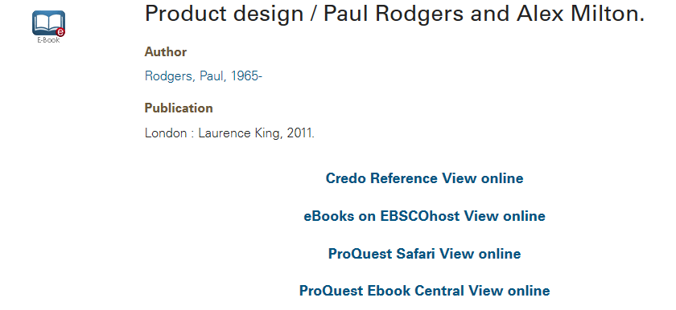
Strategic Initiative:
Merge E-Resources Expanded Project
Previous completed project merged e-resource records received through OCLC Collect Manager. Cataloging is working to merge vendor records, individual catalog records, and Collection Manager records in order to complete the goal to:
Create a single entry point for each title
Regardless of where the record was retrieved from
Update records to current metadata standards
Collections & Digital Content
Cataloging & Metadata Services
2020-2022

Slide 32
Strategic Initiative: PCC Wikidata Project-Linked Data Initiative
Work with the PCC (Program for Cooperative Cataloging) to add Wikidata information improving search engine ranking and increase visibility for Texas State University faculty, archival resources and Digital Collections.
Add data or create Wikidata records for Texas State University faculty
Link NACO authority records to Wikidata-creating a linked data structure for identification management
Add Archives at links to donor archives and finding aids
Add Wikidata information and links for Digital Collections objects and content
Collections & Digital Content
Cataloging & Metadata Services, University Archives, Digital & Web Services
2020-2022

Slide 33
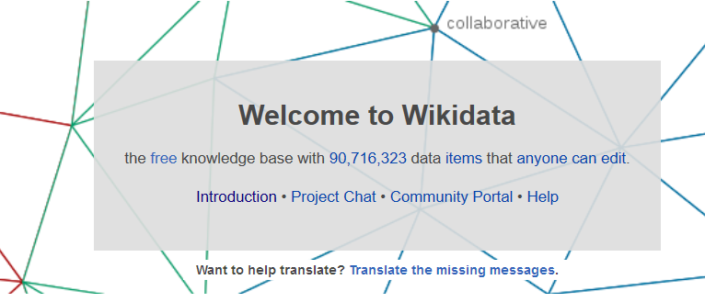
Strategic Initiative: PCC Wikidata Project-Linked Data Initiative
Wikidata Portal

Slide 34
Questions
2020-21

